Slide 1

TECHNO INTERNATIONAL NEWTOWN DSA PROJECT PROJECT NAME: FIND 5 CLOSEST FRIENDS IN A SOCIAL MEDIA PROFILE DEPENDING ON LATEST ACTIVITIES
GROUP MEMBERS:
ANWARUL HAQUE
PIYUSH KUMAR BYAHUT
POUSHALI GHOSH
TAHSEEN ATIQUE ALI

Slide 2

SOCIAL MEDIA: Social media refers to the means of interactions among people in which they create, share, and/or exchange information and ideas in virtual communities and networks.
SCOPE OF STUDY:
On a personal level, social media allows you to communicate with friends and family, learn new things, develop your interests, and be entertained. On a professional level, you can use social media to broaden your knowledge in a particular field and build your professional network by connecting with other professionals in your industry.
PROBLEM STATEMENT:
THIS PROJECT TAKES AN IN-DEPTH LOOK AT THE ROLE OF SOCIAL MEDIA IN COMMUNICATION THROUGHOUT THE WORLD AND ALLOWS PEOPLE TO CONNECT FROM ANY CORNER OF THE GLOBE ANYTIME.

Slide 3
ApplicationS of social media:
1. Building Relationships and Staying Connected-
Social media can make it easy to find groups of like-minded people or make new friends.
2.Spreading news-
News from just about any part of the world can spread like wildfire on social media social media.
3.Showing empathy and kindness-
Seeing others work through tough times can also be inspiring and help us see things from a new perspective.
4.Stay up to date-
You can stay in touch with what’s happening in your industry or world by following people on social media who are doing things you want to be doing.

Slide 4




MODULE
Main()
create_account()
isValidUsername()
IsUsernameTaken()
isValidPassword()
Login()
Printmenu()
Generate_data()
readfile()
printData()
calculatePoints()
sortData()
printTop5()

Slide 5
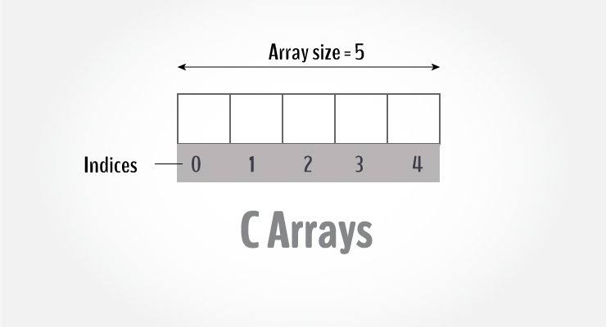
Entities used in the Code -
DATA STRUCTURE USED –
ARRAY OF STRUCTURES –
An array of structures is a data type in programming that allows the storage of multiple values of different data types in a single entity. This structure makes it easier to handle and manage large amounts of data in a more organized and efficient manner. Instead of declaring multiple variables to store different values, we can use an array of structures, where each element of the array represents a unique instance of the structure with its own set of values. This allows us to manipulate, sort and perform operations on the data in a streamlined fashion. In essence, arrays of structures provide a convenient and powerful tool for managing complex data structures in a program.
OTHER ENTITIES USED –
File handling, Structure, Pointer, Functions.

Slide 6
Flow Chart
Check for valid Username
Check for Username is already taken or not
Login Menu
Check for Valid Password
1. Create account
Store the username and password into accounts.csv
2. Login
3. Exit
Check accounts.csv file for username and password
Open Main Menu

Slide 7
Main Menu
1. Generate Data
Creates a CSV file containing 100 random names along with their recent activities.
2. Read Data
Reads a CSV file containing the recent activities of 100 friends and stores it into an array of structures.
3. View Data
The code prints recent activities of 100 friends stored in an array of structures.
4. View Point Calculation Criteria
Displays the point calculation matrix
5. View Calculated Points
Calculates the points for each friend based on their recent activities and sorts the data in descending order by points, then prints the result.
6. View Result
Prints the top 5 closest friends with their points based on the number of records available.
7. Logout

Slide 8

ANALYSIS
PROBLEMS OF THE EXISTING SOCIAL MEDIA (WITH SOLUTIONS)–
1.Spending Too Much Time on Social Media- Social networking can be addictive and overwhelming at the same time. You need to learn to filter out the ‘noise’ to find something specific.
2.Lack of Focus and Productivity- Time ourself and remain focused in what we need to do first – everything else can come up later. Setting your priorities is essential, which ensures we only work to achieve your target.
3.The FOMO Syndrome- Remember, if we want to achieve something – We need to be very focused, or else it doesn’t work.
4.Seeking Validation- Besides, clicking our pictures, uploading the, and sharing it all over becomes an addiction, especially with young tweens and teens. Parents need to be careful because people can misuse such pictures too.

Slide 9
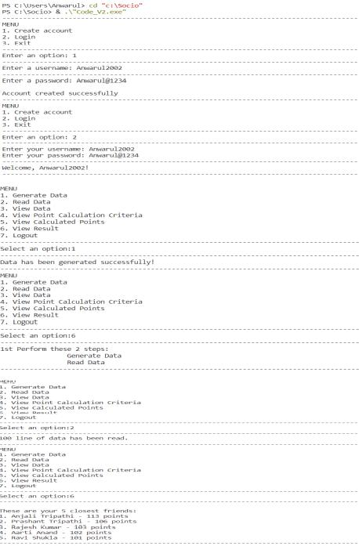
Demonstration of the program with some Results
Case 1 :

Slide 10
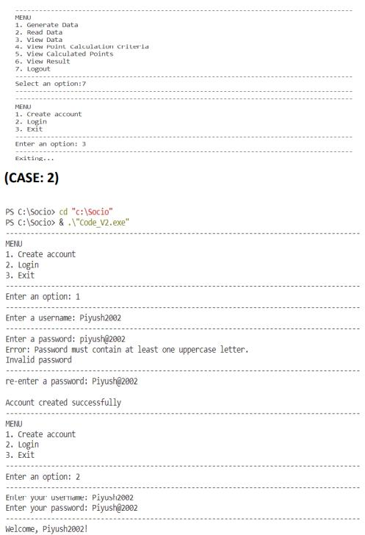
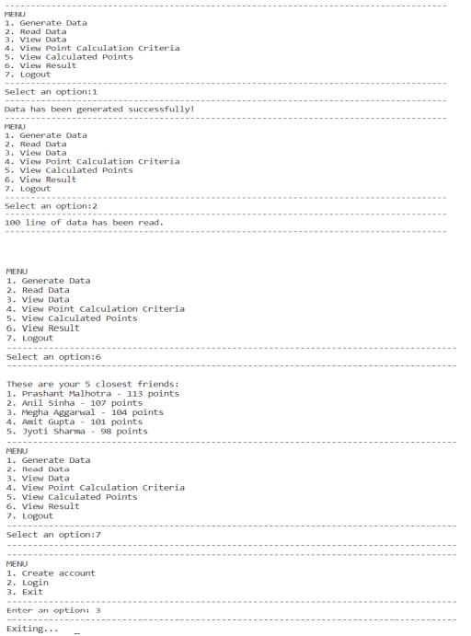

Slide 11
TAKE BACKS
Working on this project taught us how to operate in a team,distribute and take responsibilities.
As we researched in the domain of social media.We got our knowledge of the problems and did our best to solve and simplify them.
We need to work with more people to understand the full scope of the domain. This was challenging project and we did our best.
Looking forward to our next challenge.

